Slide 1
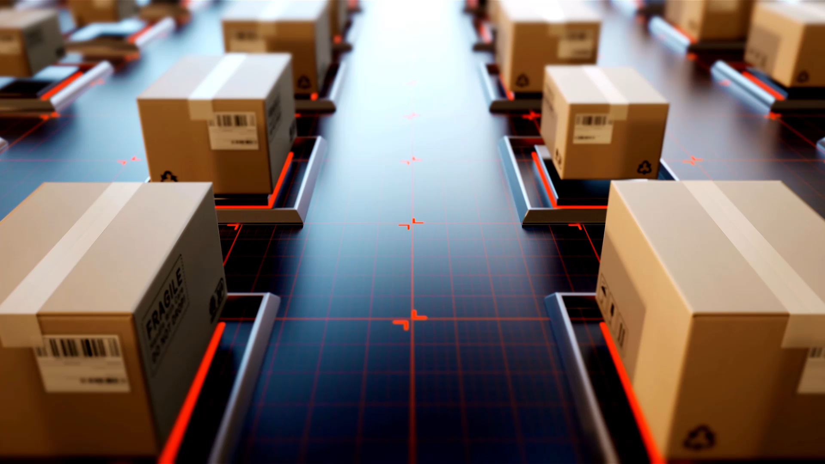
IMPLEMENTATION OF FOOD DELIVERY SYSTEM USING DRONE
By
Nandu J

Slide 2
Introduction
Taclo is a food delivery company that began its journey in 2012 with a modest setup in Bengaluru.
Starting with only 6 delivery personnel and covering 20 restaurants. Since then, Taclo has come a long way.
Today, it operates in more than 500 cities and has over 2 lakh restaurants on its platform.
With the development of business, the increasing demand for deliveries and excessive traffic during peak hours have been a difficulty
As a result, Taclo has opted to implement a drone delivery system to improve its serviceability

Slide 3
Benefits of Drone Delivery System
Speed
Speed: Drone food delivery can significantly reduce delivery time, allowing customers to receive their orders in a matter of minutes.
Efficiency
Efficiency: Drones can bypass traffic congestion and other obstacles, allowing for swift and more efficient delivery.
Cost
Cost–Effective: Drone food delivery can be more cost-effective than traditional delivery methods, as it reduces the need for manual intervention and transportation costs.
Drone
Environmentally friendly: Drone delivery is a more sustainable delivery option, as it reduces emissions and air pollution.
Reach
Accessibility: Drones can reach areas that are difficult to access by traditional delivery methods, including rural or remote areas.
Reduce
Reduce risk of accidents: Drones can reduce the risk of accidents or injuries associated with normal delivery methods.
Advance
Advance detect: Advance Detect and avoid redundancy features to ensure the likelihood of failures has been reduced to nearly Zero.

Slide 4
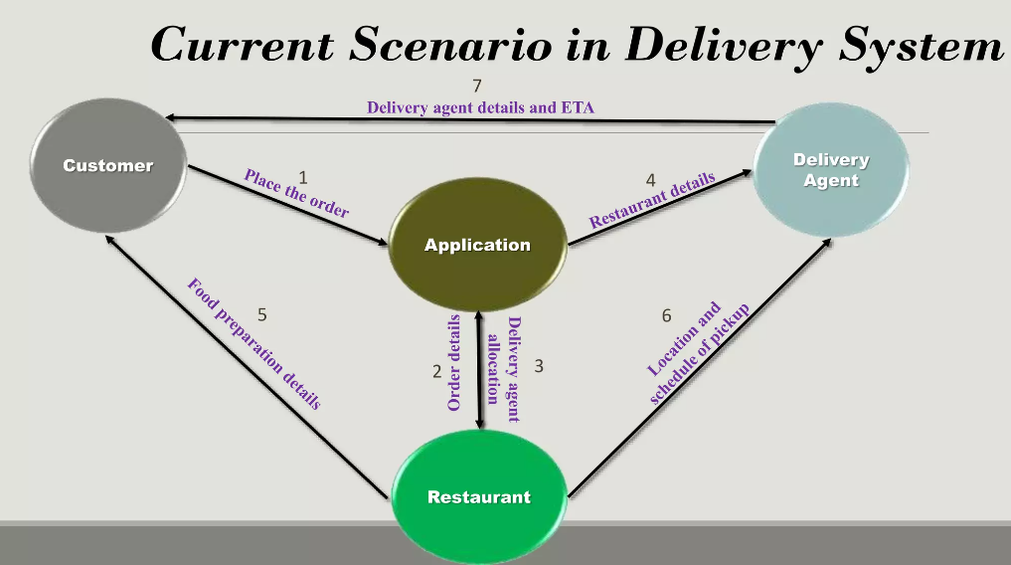
Current Scenario in Delivery System

Slide 5
Drone Specification
Autonomous flight features
Flying Range: 7 to 8 km
Average speed: 40 km
Flight time: 30 minutes
Battery Life: 3 months
Navigation Visual Sensing
Maintenance: Rs 6.5 K per month
3D obstacle sensing
Rs. 130k per Drone
Max capacity: 5 kg
Battery cost: Rs 13k
Altitude: 150-300 ft
Return to home feature

Slide 6
Proposed Drone Delivery System
Customer places the order using the Taclo app. The order placed is received by the restaurant.
Once the restaurant accepts the order, a message is sent to the nearest drone hub.
A drone is assigned with the consignment and its scheduled pick up will be given to it.
As the required estimated time of pick up(ETP) it will reach the restaurant.
Once it pickup the order a message will be sent to the customer regarding the pickup and ETP of the food.
The order is delivered to the location either to the customer or his/her representative.
Deliver to a predefined, or pre-identified drop-off point to reduce delivery time of about 15 minutes to about 3 minutes.
Once the delivery is completed, the drone will head back to the original hub. In case, it has enough battery and if get call from nearest restaurant for 2nd flight it can move directly to 2nd delivery

Slide 7
Implementation Drone System
Establishment of a drone master control Centre at every city of implementation
All The facility centres will be controlled from here
In Case of emergency, control of all the hubs will be taken from here.
For Every 5 km there will be a drone hub and a service station
Hub will be monitored by 2 master pilots.
After the assigned delivery it will reach the hub.
Pickup/Delivery of order:
To receive the food customers, must scan the QR code
The order will be delivered to the customer or his/her point of contact
If in case a drone has enough battery capacity it can go for another delivery or else repeat the previous step.

Slide 8
Phased Rollout Plan for Drone Delivery System
Phase-1:
To run a Pilot drone delivery in any one of the Tier-1 cities.
Select the high-demand area.
Collection of feedback and reviews from stakeholders.
Phase-2:
To keep the necessary improvements based on feedback received in Phase 1
Based on the results from phase 1 trying to expand to some other locations in a city or another city.
Phase-3:
Based on the results obtained from phases 1 and 2, necessary improvements will be done.
Expansion of drone delivery system to all tier 1 and 2 cities.

Slide 9
Challenges of drone delivery system
Safety Concerns
Drones can pose a safety risk to people and property if they malfunction and crash.
Weather conditions
Adverse weather conditions such as strong winds, rain, or snow can impact drone flights and delay deliveries.
Limited capacities
Drones have limited carrying capacity, which may make it difficult to deliver large orders or bulk items.
Technical difficulties
Drone technology is still relatively new and may experience technical difficulties that could impact the delivery process.
Regulatory hurdles
Drone delivery is subject to regulatory restrictions and may require permits or approvals before operation, which can be time-consuming and costly.

Slide 10
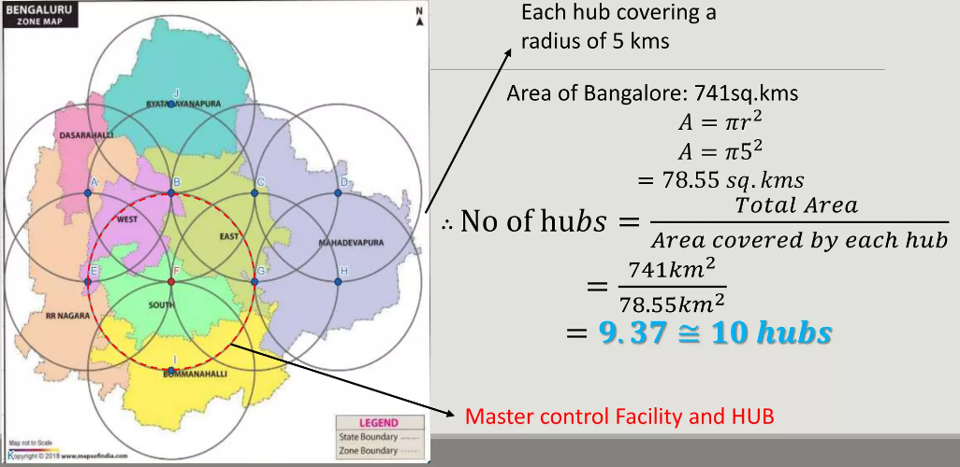
Area Of Implementation

Slide 11
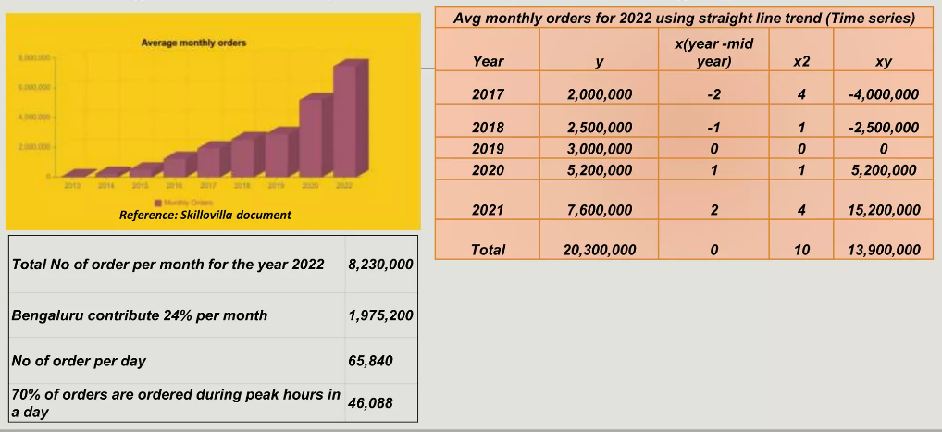
Average monthly orders of existing system

Slide 12
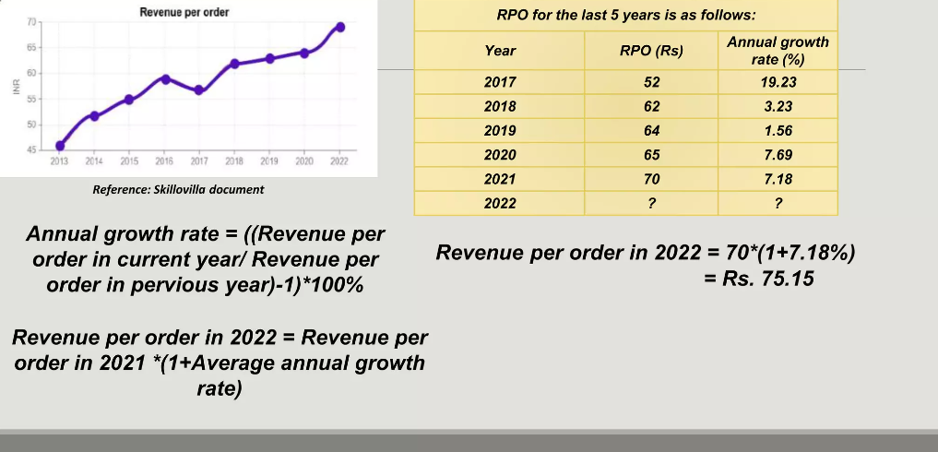

Revenue per order (RPO) of existing system

Slide 13
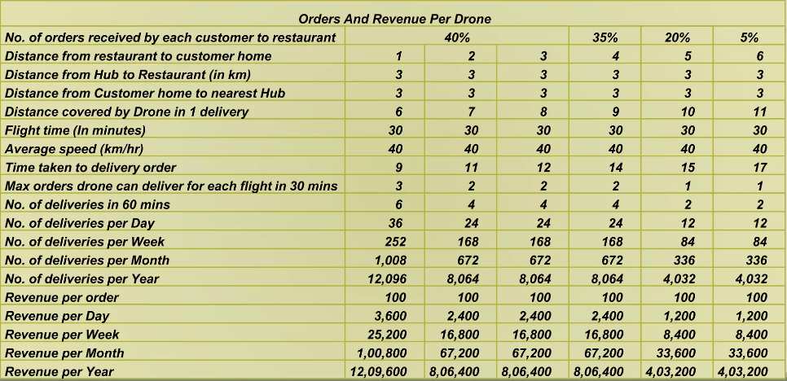
Orders and Revenue Per Drone

Slide 14
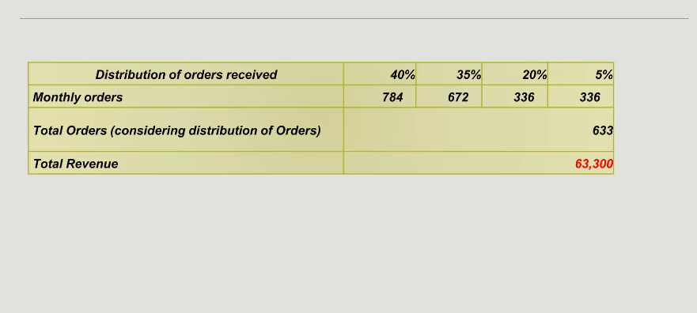
Distribution Order received per drone

Slide 15
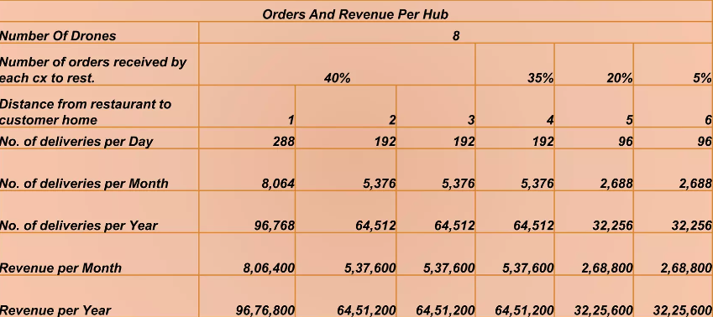
Orders and Revenue per hub

Slide 16
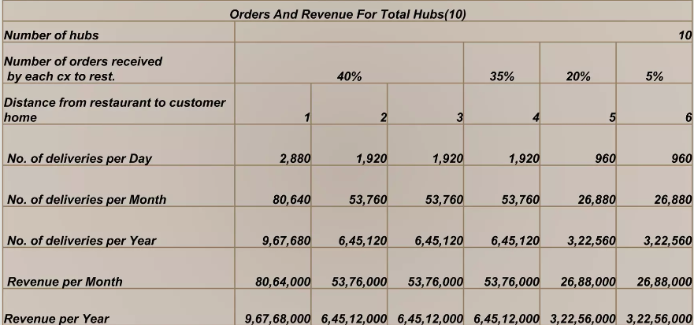
Orders and revenue from all the Hubs

Slide 17
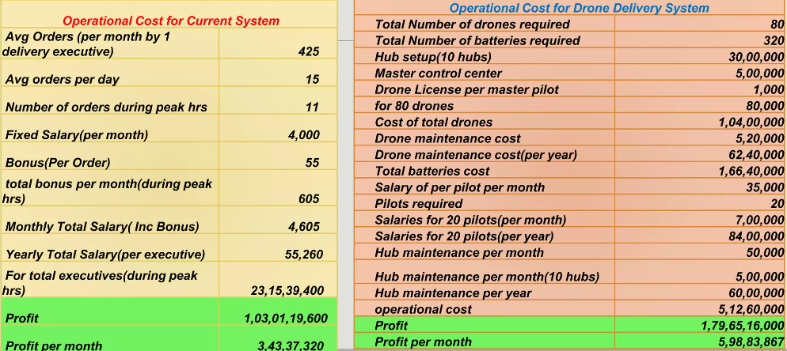
Comparison of Operation cost for both the system

Slide 18
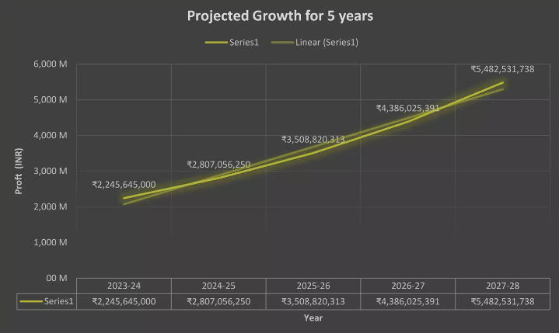
Projected growth for drone Delivery System
Considering the rate of growth 25% annual growth rate(Source Skillo Villa pdf)

Slide 19

Thank you

